Slide 1


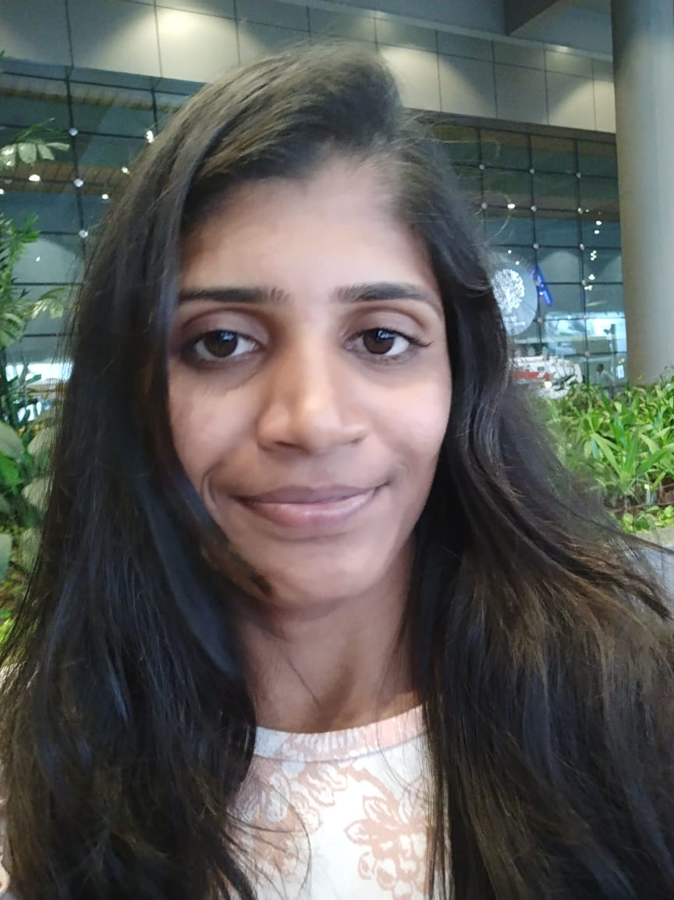

Fall 2023
DSCI – 6612 : Intro Artificial Intelligence - Term Project
Implementation of Multiple Tic-Tac-Toe Agents in a Tournament Setting.
Team Members
O
O
Sathish Gandhi Parasuram Reddy
Ramya
Boggala Ramesh
X
X

Slide 2
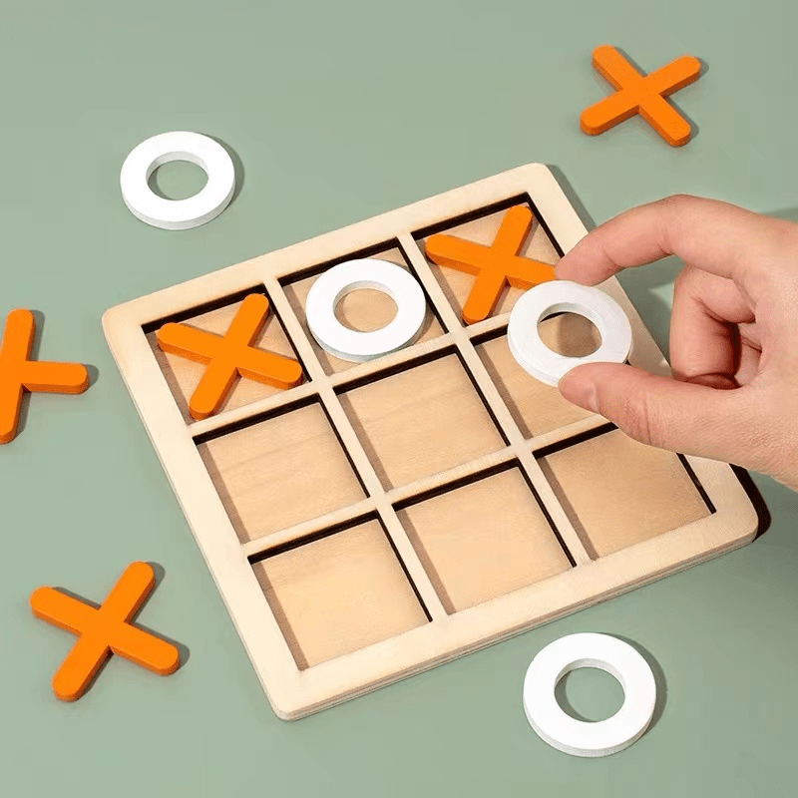
Project Title
Implementation of Multiple
Tic-Tac-Toe Agents in a Tournament Setting

Slide 3
Tic-Tac-Toe Rules
Statement of project objectives
A 3 × 3 grid is used to play the game Tic-Tac-Toe for two players. Noughts and Crosses, or Xs and Os, is another name for the game. Getting three of your symbols in a row, either horizontally, vertically, or diagonally, is the aim of the game.
We are creating four AI agents that participate in the game as players.
All AI agents involved in the game are designed by different adversarial search algorithms or Reinforcement learning algorithm of AI.
X | O
The user can choose which two agents to pit against one another in a Tic-Tac-Toe match.
If a player gets three of their symbols in a row, they win the game.
The Tic-Tac-Toe game's agents are created using the following algorithms:
X
X
X
 | X
 | X
 | X
 |  | X
 |  | X
 |  | X
Adversarial search Algorithms
Minimax algorithm with conventional methodology
Alpha-beta pruning in the Minimax method
Expectimax algorithm
In the game of Tic Tac Toe, a draw occurs when all of the squares are filled and neither player has formed a whole row of Xs or Os.
O | O | O
O | O | O
O | O | O
Reinforcement Learning Algorithm
Q-learning
O | X | O
X | O | O
X | O | X
 |  | O
 | O
O
X
 | X
 |  | X

Slide 4
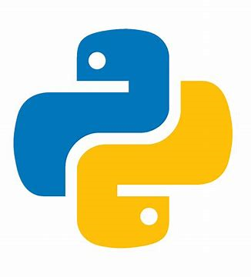
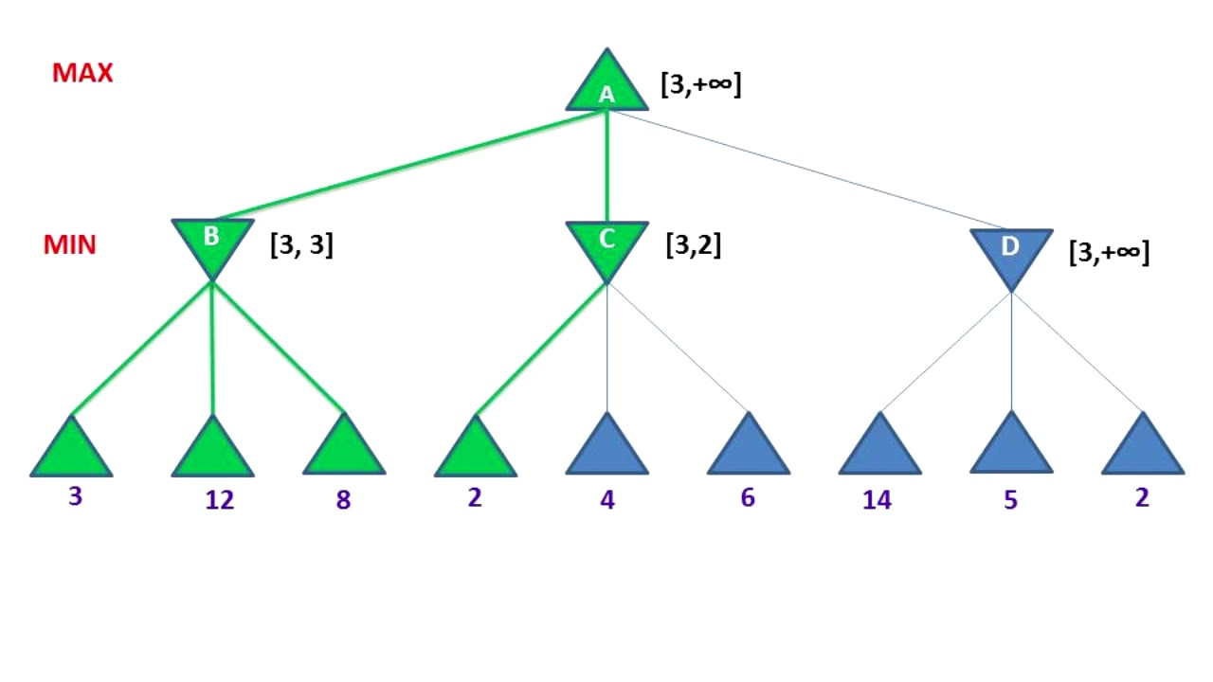

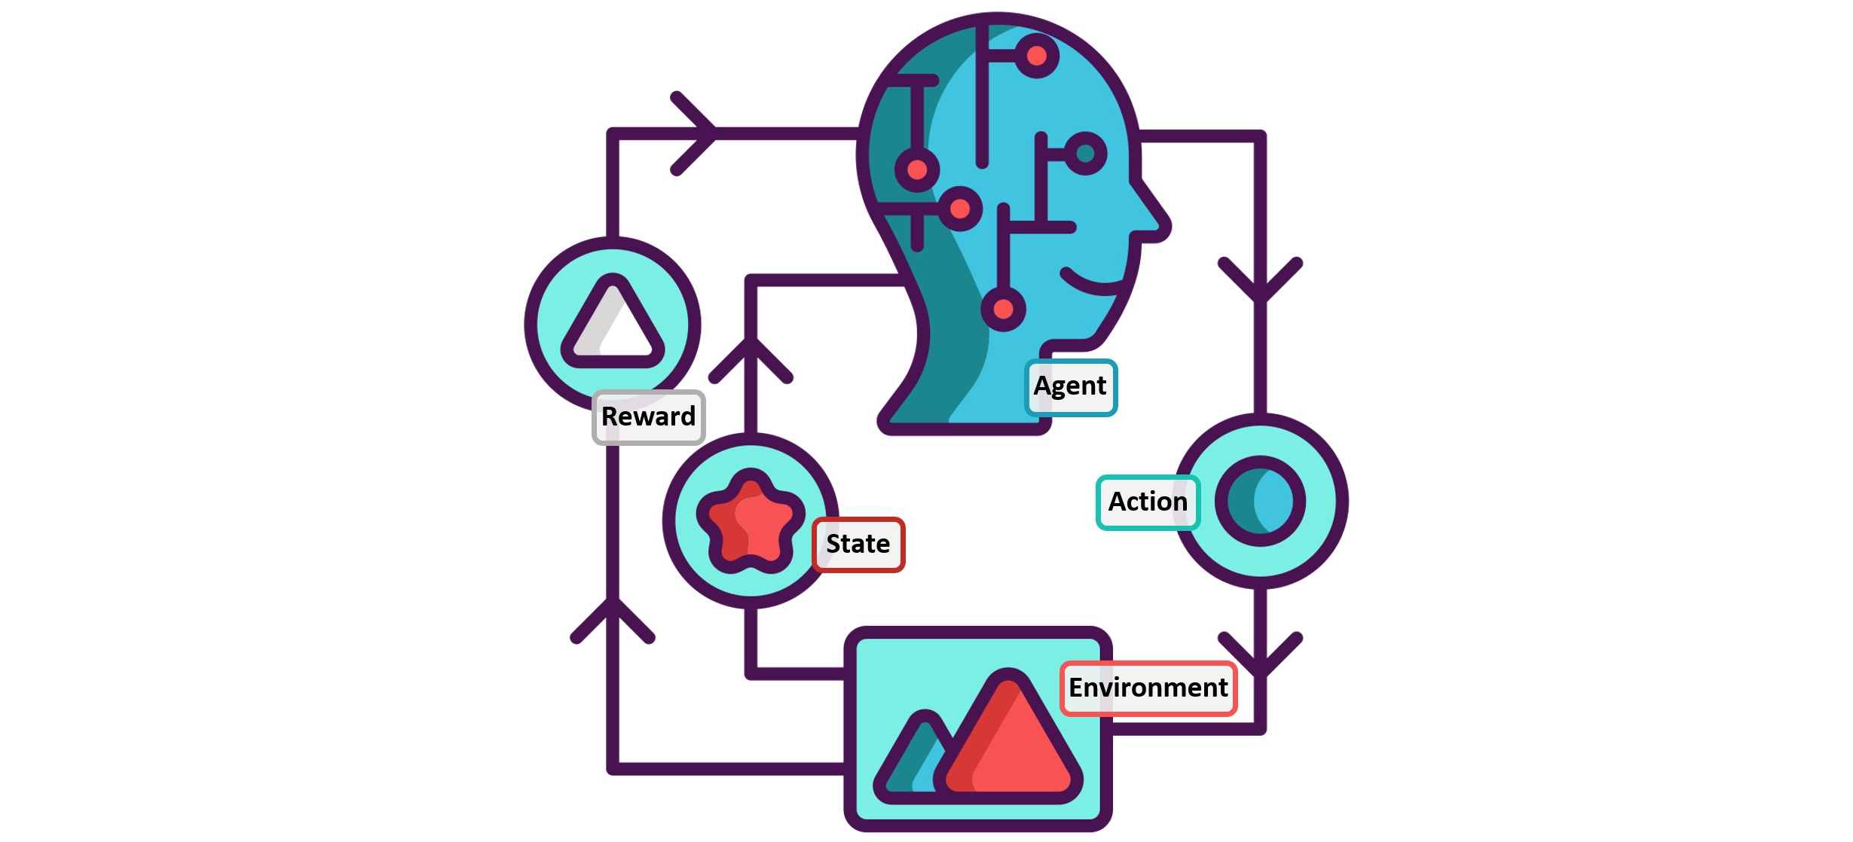


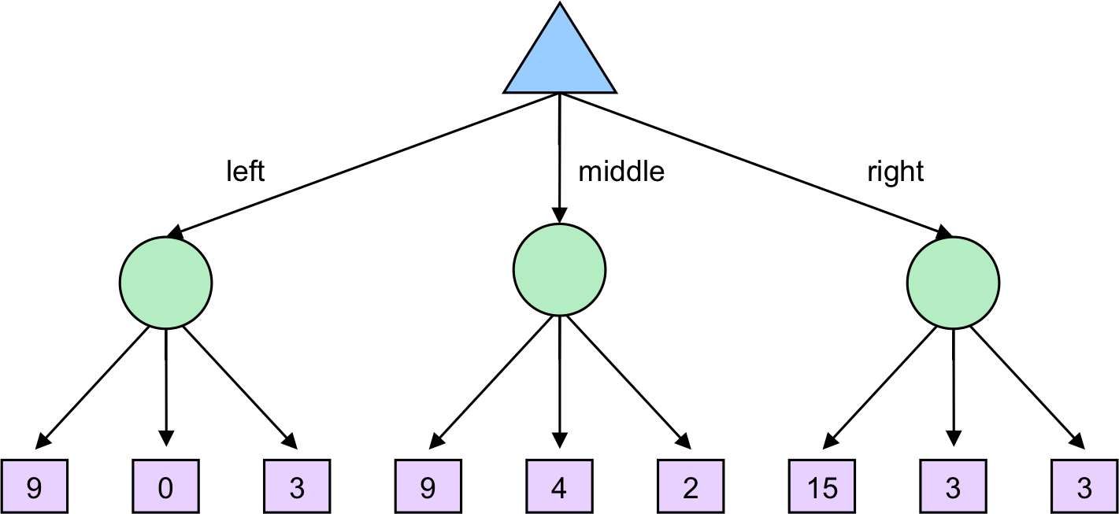
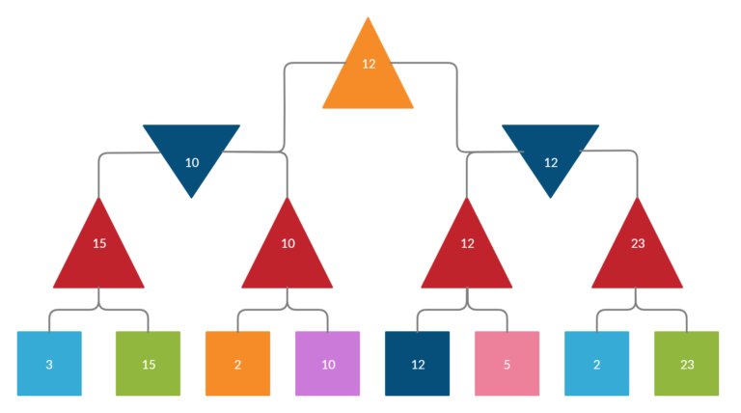
Tools
Minmax algorithm using alpha-beta pruning approach.
Q-learning - Reinforcement Learning Algorithm
Python
Jupyter Notebook
Visual Studio Code
GitHub
Techniques
Expectimax algorithm.
Minmax algorithm using traditional approach.
Tic-Tac-Toe

Slide 5





Deliverables
Documentation Report
Power Point Presentation
GitHub Repository Link
YouTube Video
Program Files (.py files)

Slide 6
Evaluation Methodology
The project is assessed based on the proper application of four algorithms for ai agents.
While making the next step, none of the agents should falter or freeze.
The agent should always aim to undermine the opponent's prospects of winning the game with their following play.
Agents ought to be taught such that the game appears correct as though two human brains are playing it.

Slide 7
Code Demonstration

Slide 8
Thank You

